Slide 1


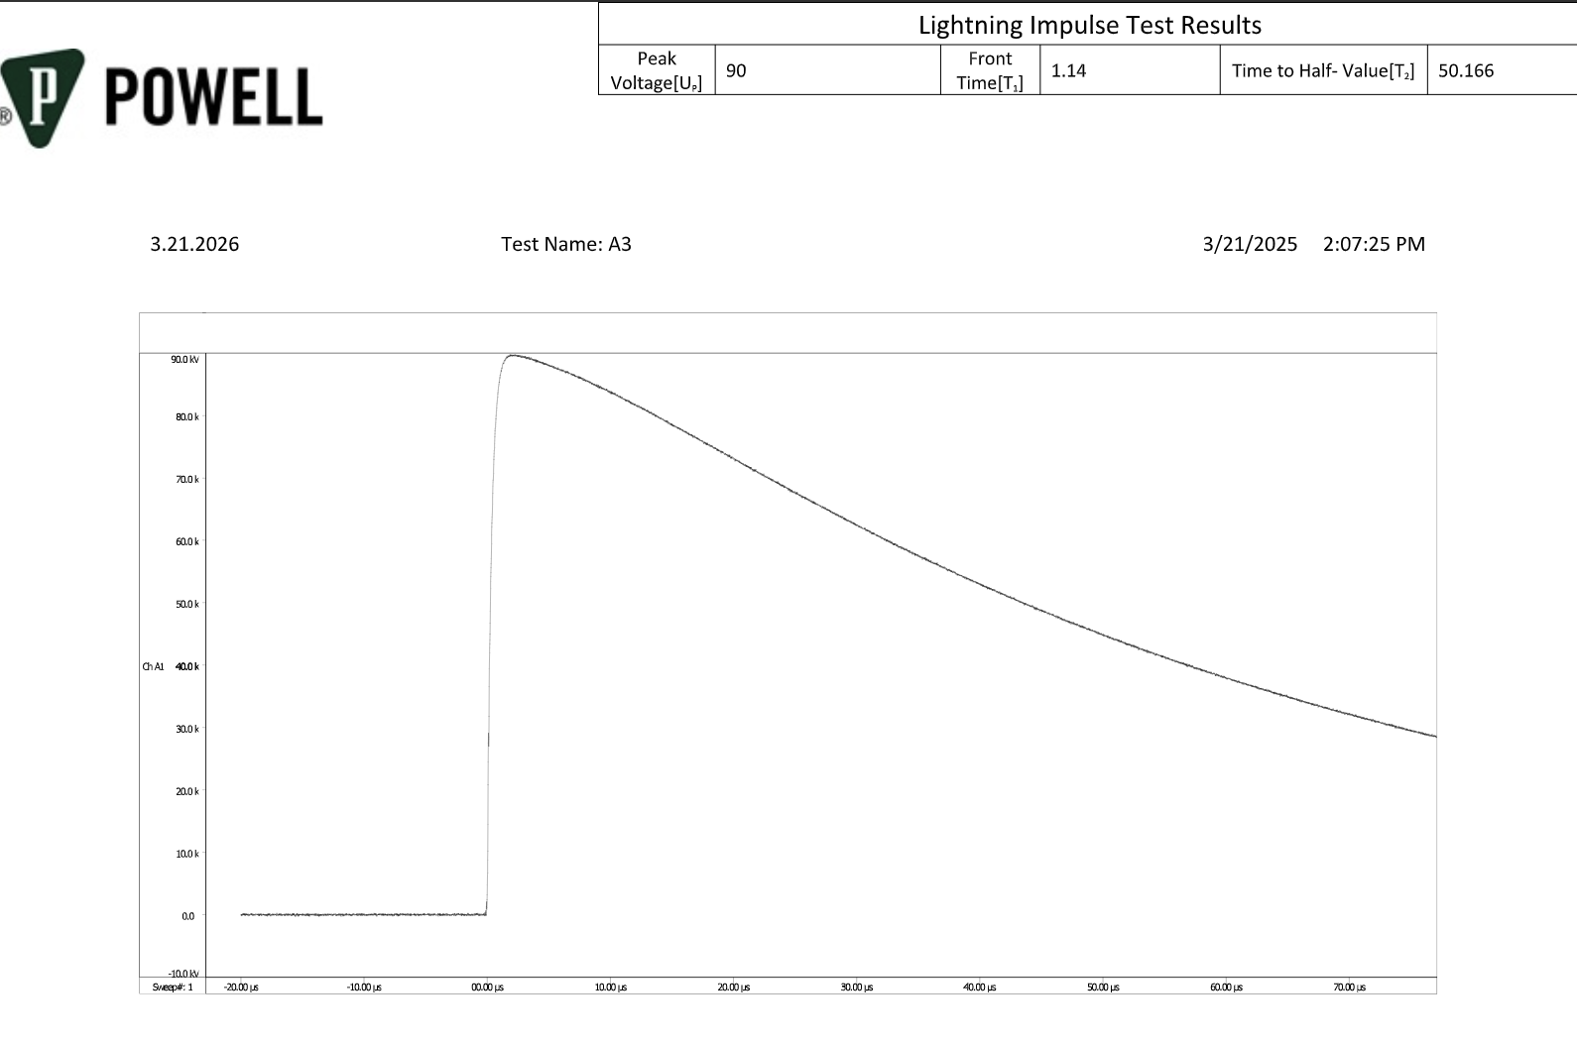
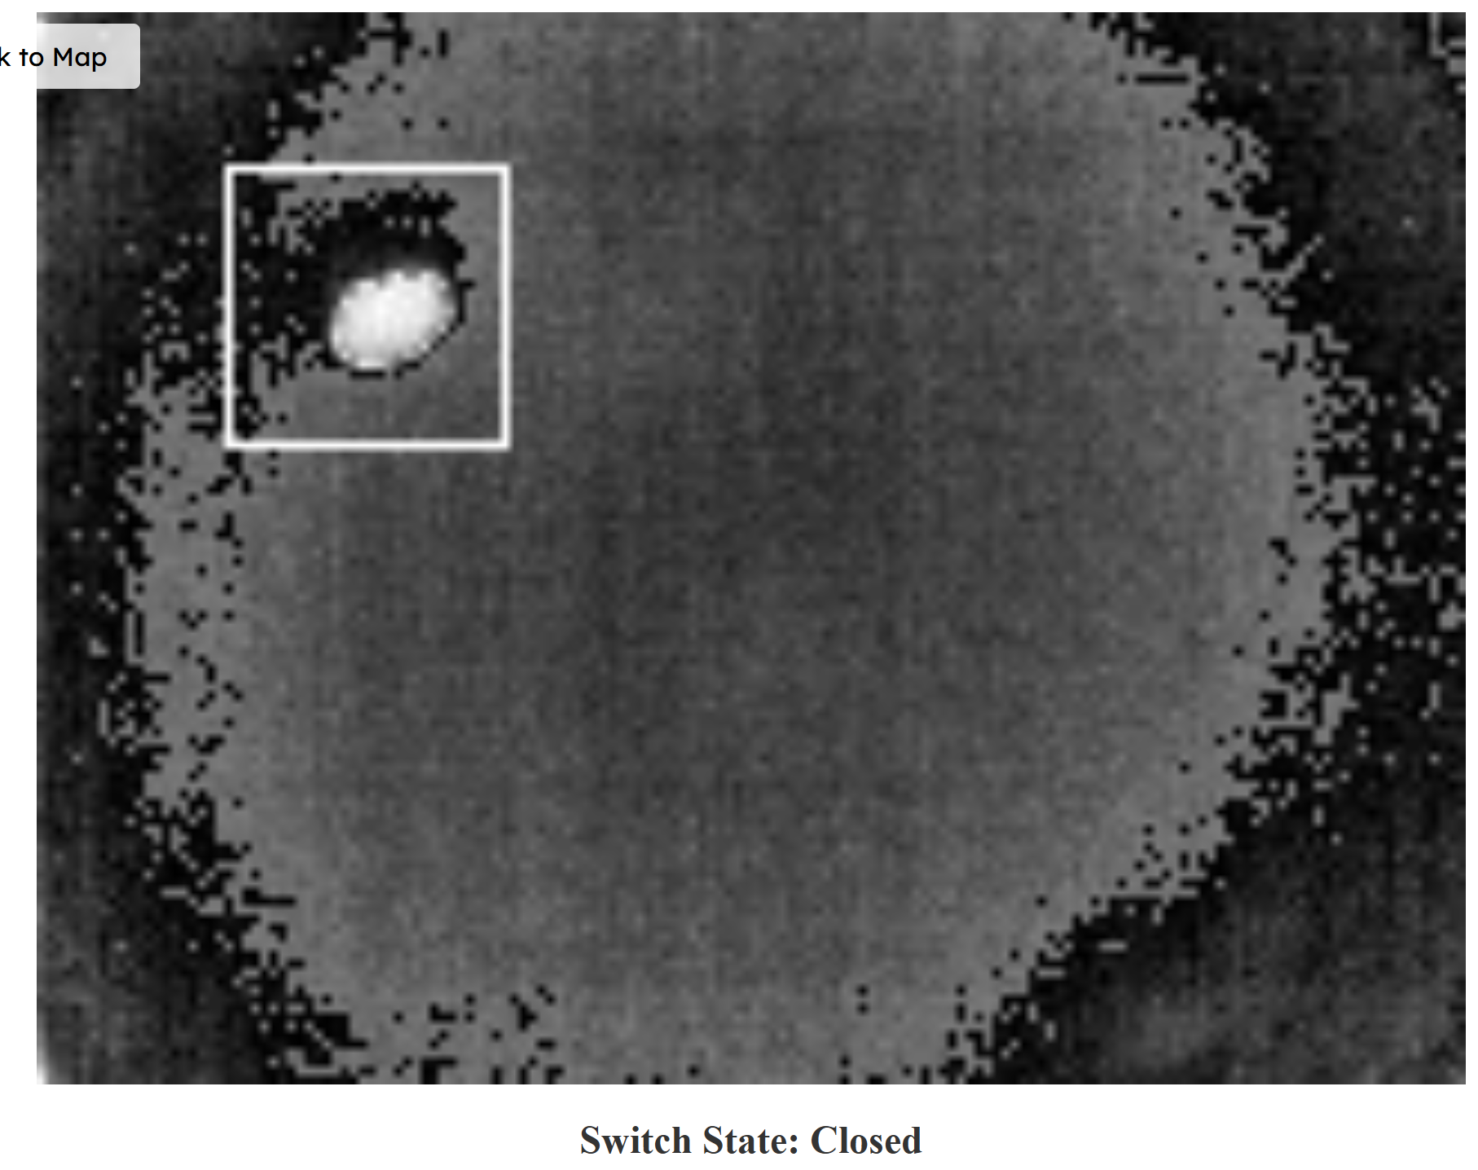
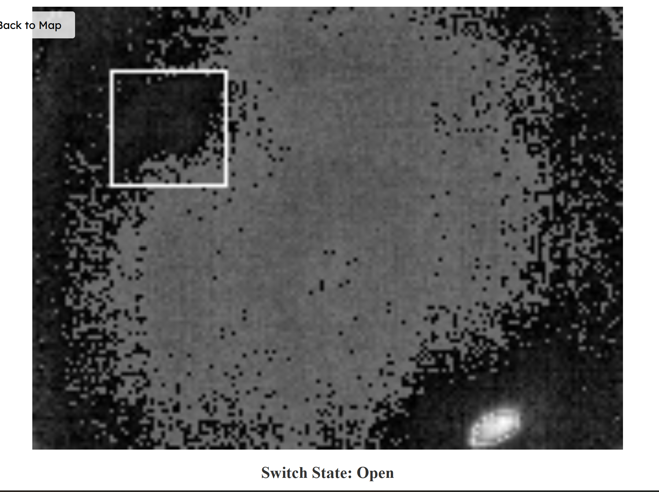
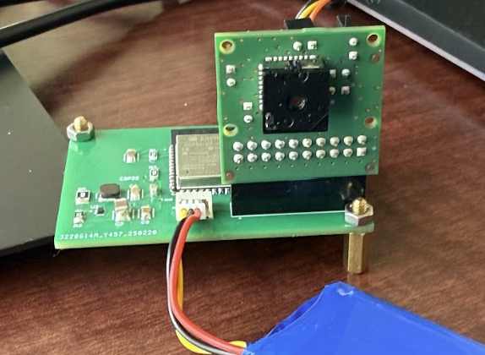
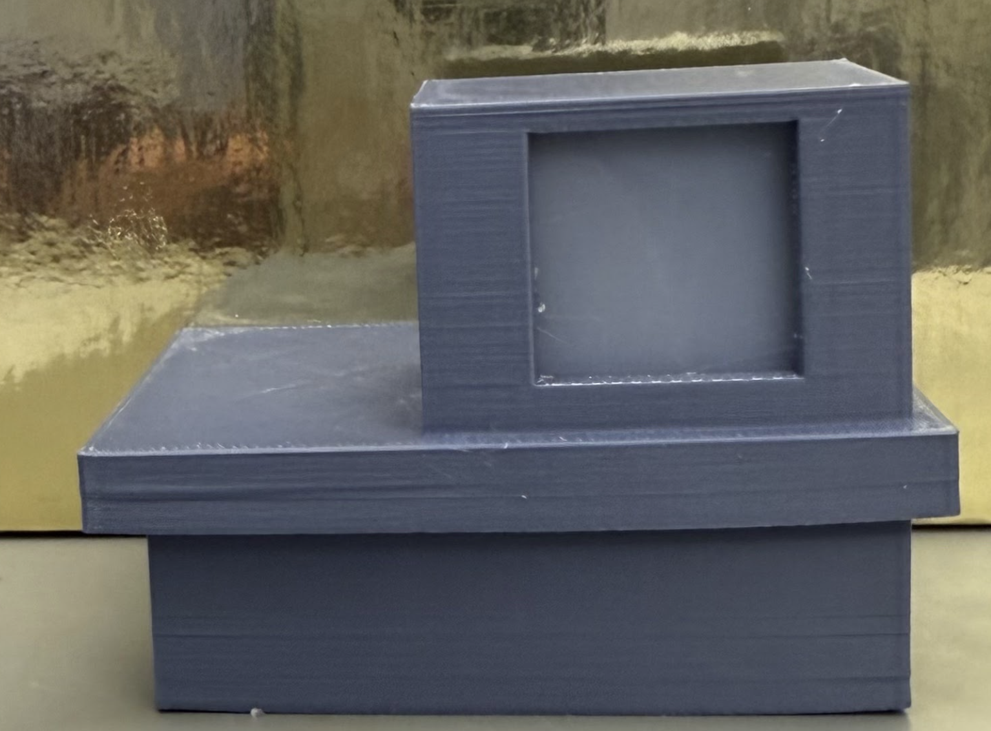
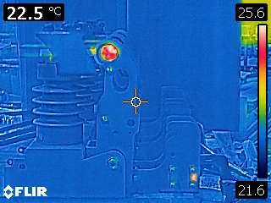
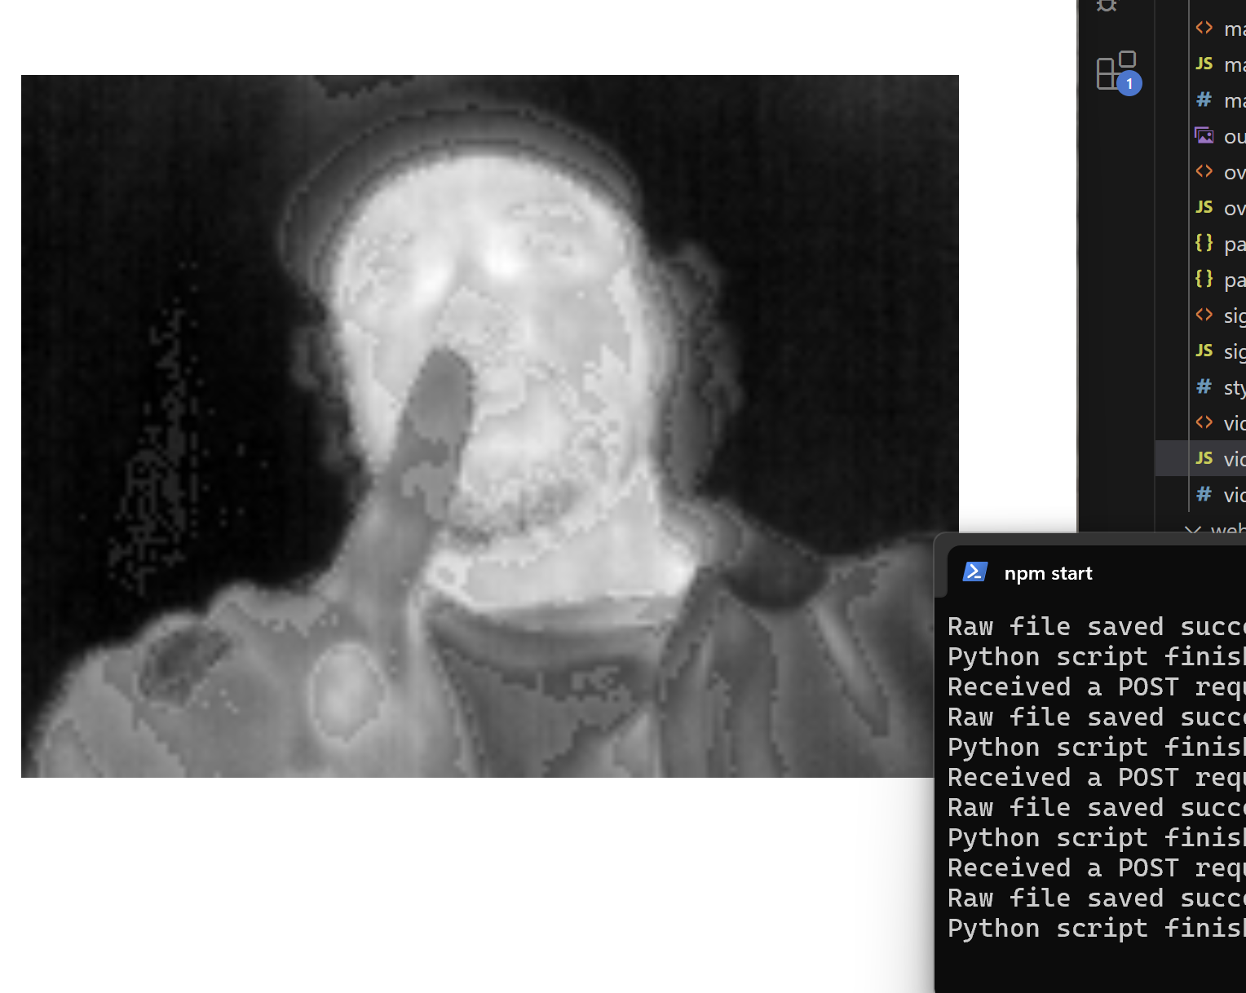
EPS Booth: 357
Remote Viewing within High Voltage Apparatus
Blake Bagley, Julia Garcia, Erica Mathew
Professor Enjeti
Problem Definition
As industry demand grows, space inside high voltage switchgears have become increasingly limited. Manufacturers are now required to fit more devices and wires within the same limited space. Additionally, the safety of operators, when working with this gear, is dependent on a grounding switch that isn’t easily viewable. Our project was to create a video system to allow the operator to remotely view the state of the switchgear.
Engineering Analysis
A majority of our analysis consisted of taking thermal images of the grounding switch to see how we would handle the automated detection and how our system would affect the dielectric integrity of the switchgear. When looking at Figure 1, you can see the circular side of the switch’s contact has a higher temperature compared to everything else [See Figure 1]. This information allowed us to design the automated detection system to be determined by the location of the heat signature for the switch’s contact.
When considering the dielectric integrity of the switchgear, a lot of our decisions were based around the materials we used for the encasing. We decided on ABS plastic due to its insulating properties and heat resistance. Tests were later conducted at Powell to confirm our system would not compromise the dielectric integrity. Figure 2 shows a successful BIL test at 90 kV [See Figure 2]. With these results, Powell approved of our design for the integrity of dielectrics.
Closed
Figure 2. Successful BIL Test at 90 kV
Outcomes
Our project was fully validated and performed all of its intended tasks. The thermal sensor was able to accurately take image data and send it to the microcontroller to be displayed on the website. The website continuously displayed these image frames as they updated. A slow, clear video stream is displayed on the website for easy viewing. The system was also able to accurately determine the switch state and display it on the website [See Figure 5].
Open
Solution
Our solution was to create a thermal remote viewing system that will be placed inside the switchgear in view of the ground switch. A website will then be connected to the microcontroller through Wi-Fi. The system has two major functions.
Switch Viewing
The thermal camera will send its pixel data to the microcontroller. The microcontroller will then compress the data and send it to the website to be viewed [See Figure 4].The image frames will be sent one by one to mimic a slow video stream.
Automated Detection
When receiving the pixel data from the thermal camera, the microcontroller will process that data and make a determination on whether the switch is open or closed.
Figure 5: Website display of Switch State
Impact
Our project was created to make the switchgear operator’s job safer and more convenient. It has no effect on the integrity of the switchgear. There are no environmental, social, or ethical concerns.
Side view of the switch’s contact.
Figure 3: Thermal Camera PCB and Encasing
References
ESP32-S3 Series Datasheet - Version 1.9
FLIR LEPTON® Engineering Datasheet - Revision 400
GlobTek, Inc. Li-Ion Polymer 3.7V Battery Pack - 12/22/2020
DS-16912-FLiR Lepton Breakout Board - Version 2
Female_Headers.100_DS - Revision 100
Acknowledgements
We would like to thank Jay Yelvington, our Powell industries contact and all the professors and TAs who helped us along the way.
Figure 1: Thermal Photo of Grounding Switch
Figure 4: Thermal Image

